Slide 1
IEEE 754 ENCODER/DECODER
SHAQUILLE DAVID
MOHID SHARIF
JUNAYEED RAHMAN

Slide 2

INTRODUCTION
Develop an IEEE 754 Converter:
Encoder: Takes a decimal number and converts to IEEE-754 Floating-Point representation
Decoder: Takes 32-bit Floating-Point and converts to Decimal
Design a User-Friendly Graphical User Interface that can be used by anyone

Slide 3
01
OVERVIEW

Slide 4
ABOUT IEEE-754 Floating Point Representation
What is IEEE-754 ?
IEEE-74 is the most common representation for real numbers for computers (PC’s, Macs, Linux)
The approach to representing Real Numbers on computers
Has developed to become universally adapted
Two Types of Representations: Single-Point (32-Bits) and Double-Point (64-Bits)

Slide 5
02
CODE

Slide 6
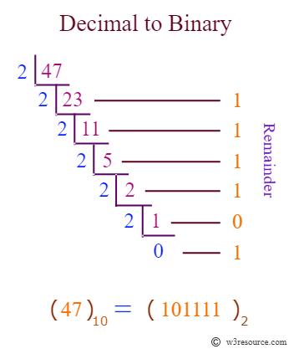
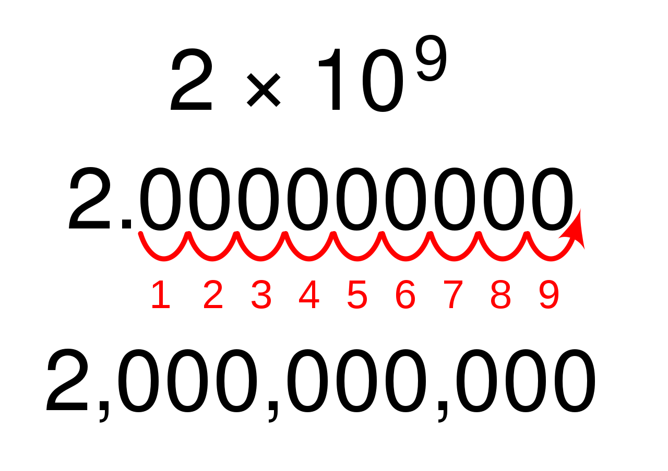
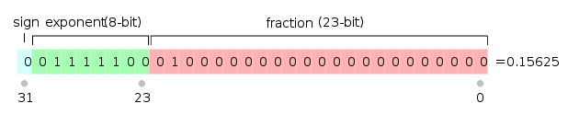
Encoding: Decimal to IEEE-754 Representation
Step 1:
Convert to Binary
Step 3:
Convert to IEEE-754 Representation
Step 2:
Represent Binary number in Scientific Notation
Convert the decimal number to binary using a series of divisions by 2.
It is necessary to know the exponent. This will be added to the “Bias” (127).
1st bit represents the sign.
Next 8 bits represent the exponent.
Final 23 bits are the fraction bits.

Slide 7
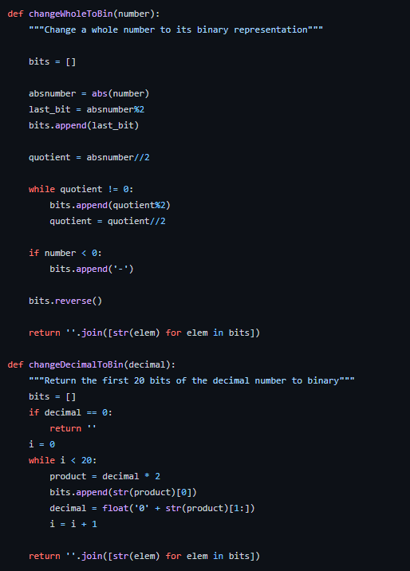
ENCODER CODE SNIPPET

Slide 8
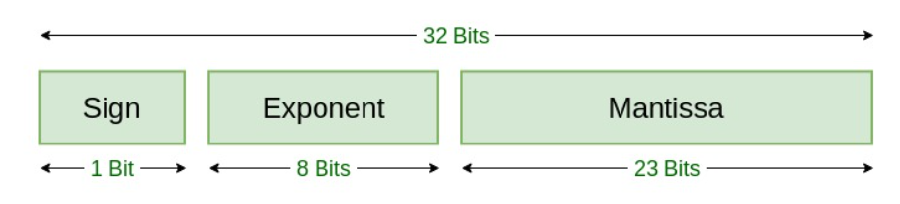
HOW DOES IT WORK?
Decoding
A 32-Bit Floating-Point consists of 3 Features:
Sign Bit
Exponent Bit
Fraction Bit (Mantissa)

Slide 9
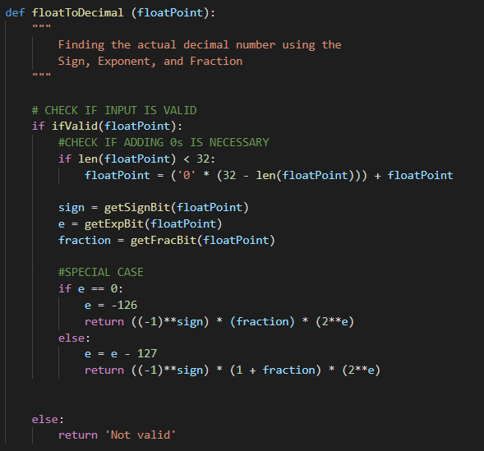
DECODER: PUTTING IT TOGETHER
Decimal = (-1)^{sign} x (1 + fraction) x 2^{(exponent - 127)}

Slide 10

I LOVE BINARY…
EVERY SINGLE BIT OF IT

Slide 11

DEMO TIME:

Slide 12
THANKS!
Do you have any questions?

Slide 13
RESOURCES
Helpful Links:
https://www.geeksforgeeks.org/ieee-standard-754-floating-point-numbers/
http://cs.boisestate.edu/~alark/cs354/lectures/ieee754.pdf
https://steve.hollasch.net/cgindex/coding/ieeefloat.html

